Slide 1
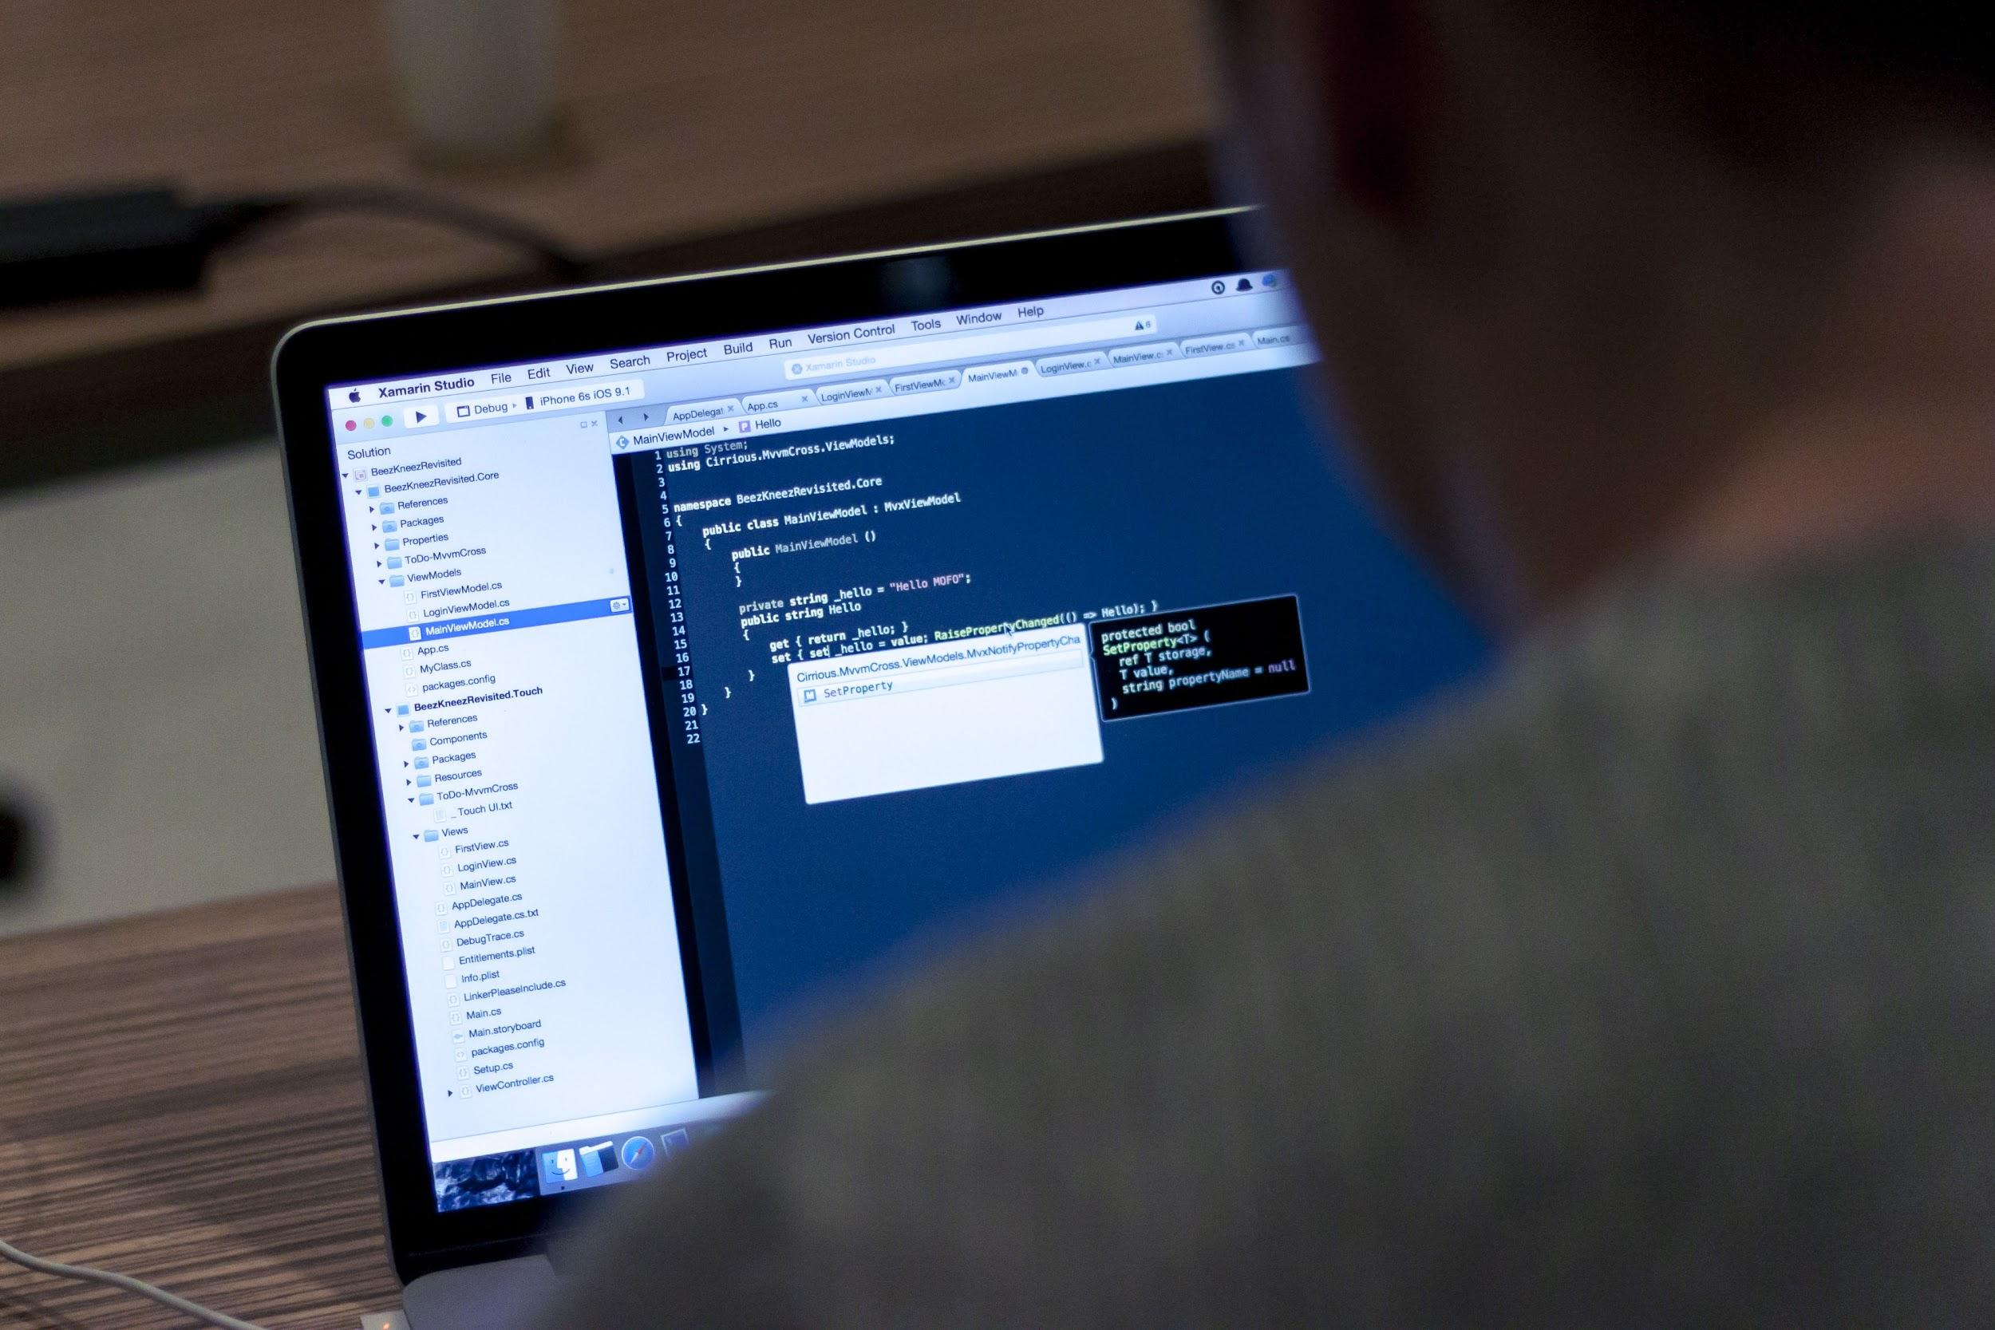
JavaScript 104
Arrays, Objects, Loops

Slide 2

Prep for class
Complete Treehouse Javascript Loops, Arrays and Objects lesson: https://teamtreehouse.com/library/javascript-loops-arrays-and-objects [266 min]

Slide 3

Last Class Topics
Function Breakdown
Declarations
Expressions
Anonymous
Parameters
Invoking function
Event Listeners

Slide 4
Today’s Topics
Arrays
Objects
Loops
for()
while()
Concatenation

Slide 5
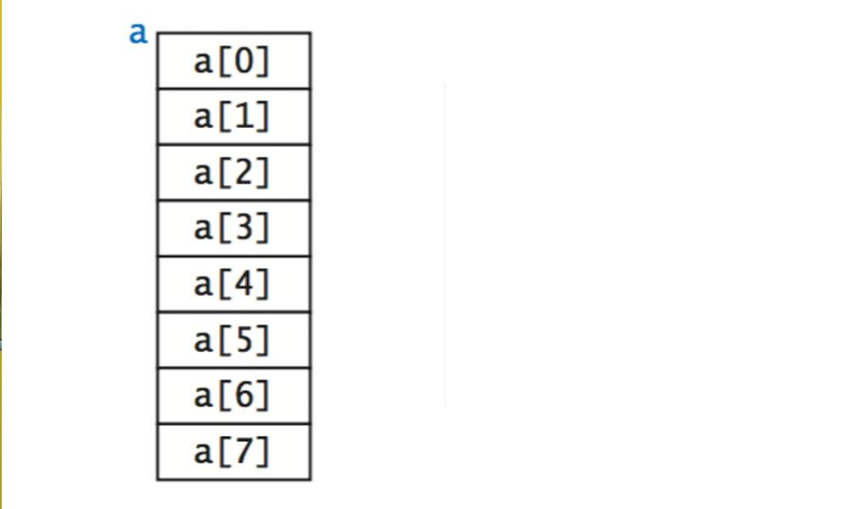
Arrays
Grouping things is fun!

Slide 6
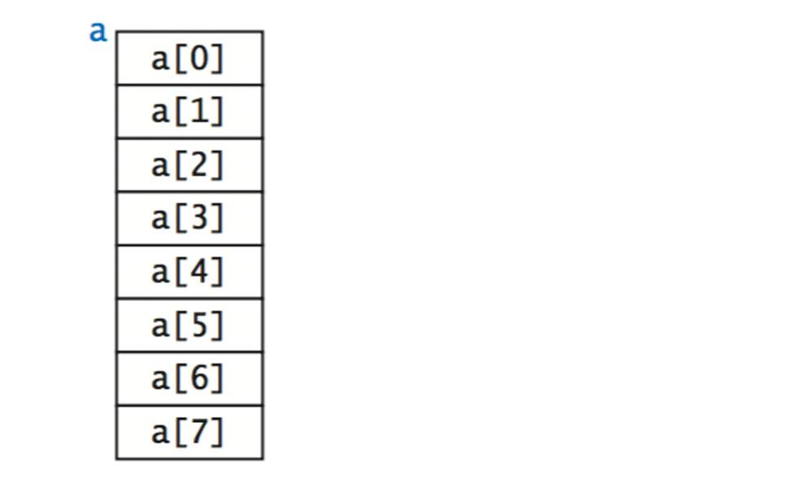
Array’s Definition
Arrays are essentially variables which can hold multiple values.
Consider the following variables, each of which holds a single value:
var name1 = 'Fry'; var name2 = 'Bender'; var name3 = 'Leela'; var name4 = 'Professor';
This is useful, but as we add more names we need more variables, and this quickly becomes cumbersome, especially when we want to do things like search, sort, and alter the entire group of names.
It’s much easier to store all of our names in an array:
var characters = ['Fry', 'Bender', 'Leela', 'Professor'];

Slide 7
Array Management
All of our items (in this case, names) are in one variable so there is no need to remember the many different variable names. Because all the items are stored in a single array, you can easily add and remove items, and much more.
Individual array items are accessed via a key (also called an index). You specify the key/index by using [ ] (square brackets) and putting in a number, e.g.:
console.log( characters[0] ); // Fry
Note: array indexes are 0-based, meaning the index of the first element is 0, not 1.

Slide 8
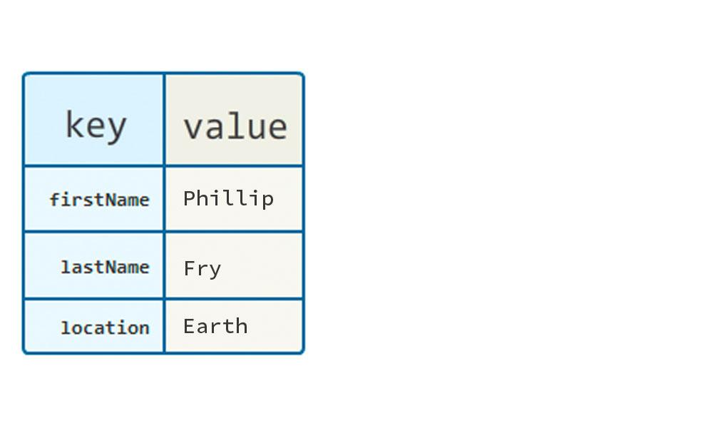
Objects
Add some structure to your structure.

Slide 9
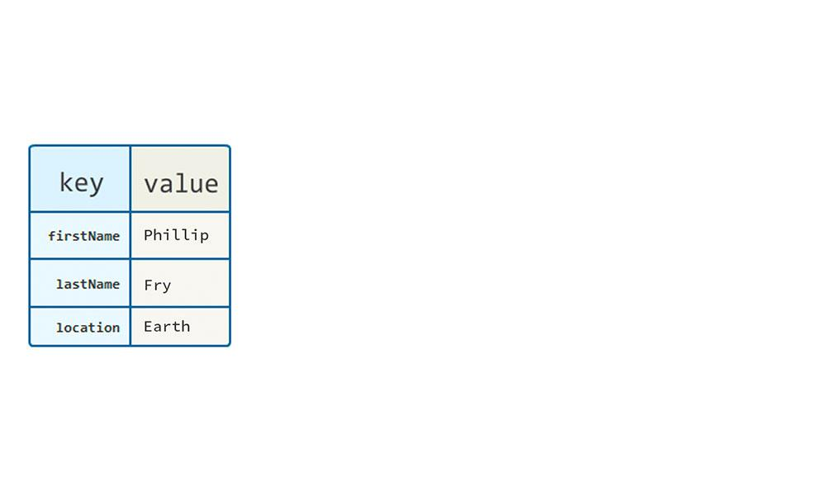
Object Definition
An object is a collection of properties and values. An object’s properties are similar to an array’s keys.
A property's value can be a function, in which case the property is known as a method.
var myFirstObj = { fname: 'Philip', lname: 'Fry', do_it: function(){ console.log('I am from the method'); } }

Slide 10
Object Basics
An object’s properties are accessed via dot notation. For example, to retrieve the value of the property fname in the myFirstObj variable:
var myFirstObj = { fname: 'Philip', lname: 'Fry', do_it: function(){ console.log('How are you?'); } }
console.log( myFirstObj.fname ); // Logs 'Philip'
myFirstObj.do_it(); // Logs 'How are you?'

Slide 11
Object - Practical Example
Let's look at this in context of characters from our favorite TV show. Though it's useful to have an array of names, I probably want more information about each character. So, let’s build an object that contains some information:
var character1 = { name: 'Fry', age: 25, location: 'Earth', species: 'Human', famousSayings: [ 'Shut up and take my money.', 'I\'m walking on sunshine... wooooah oooh oh!' ] };

Slide 12
Object - Practical Example
This is a much more descriptive piece of information that can be utilized in many different ways. Now, let's access the last name and home planet.
console.log(character1.name); // Fry console.log(character1.location); // Earth

Slide 13

If Arrays are a collection of values and Objects are a set of Key/Value pairs...
Can you put an object in an array?

Slide 14
Object - Practical Example
Much like we said name1 and name2 were bad, why would character1 be any different? It wouldn't. What would make sense is to create an array and store the objects in there.
var characters = [ { name: 'Fry', age: 25, homePlanet: 'Earth', species: 'Human', famousSayings: [...] }, { name: 'Bender', age: 25,
…. },
{ name: 'Leela', age: 27, homePlanet: 'Earth', species: 'Mutant', famousSayings: [ 'Heeeyah', 'You gotta do, what you gotta do.' ] } ];

Slide 15
Object - Practical Example
Now we get the best of both worlds. We get the ability to store like data, loop through it, and manipulate it. As well as, detailed information about the subject I am interested in.
Knowing that we access the arrays via an index. How do I access Bender’s object?
console.log(characters[1].name); // Bender

Slide 16
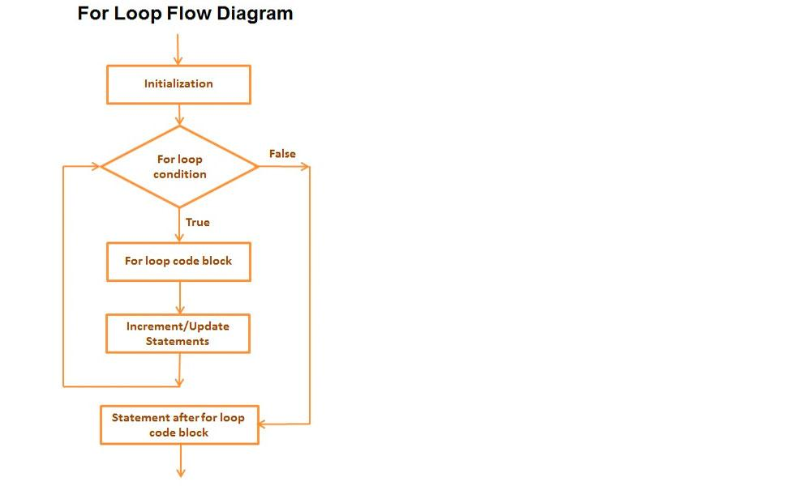
Looping
Do this over and over and over until don’t.

Slide 17
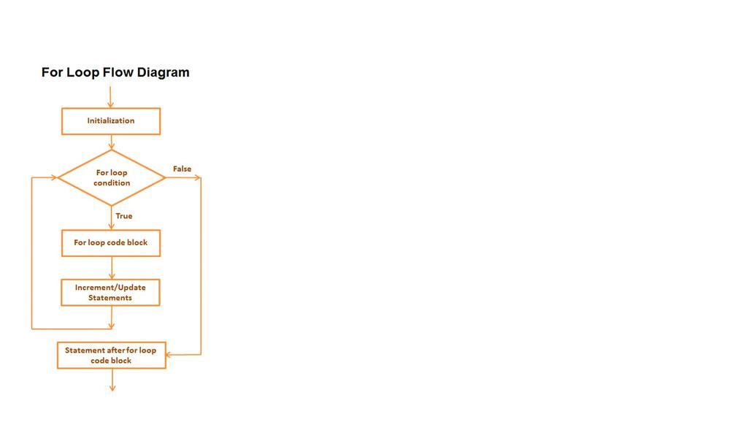
“for” Loops
Loops check a condition, and if that condition is true, a block of code will run. These steps will repeat until that condition is false. Let's look at a for loop:
for( var i = 0; i < characters.length; i++ ){ console.log( i, characters[i] ); }
console.log("Finished loop.");
A for loop has four parts:
The initiator: var i = 0
The condition to check: i < characters.length.
The block of code to run: { // everything between these }
The iterator: i++

Slide 18
“while” Loops
Let’s rewrite our for loop...
for( var i = 0; i < characters.length; i++ ) { console.log( characters[i] ); }
...as a while loop:
var i = 0;
while( i < characters.length ) { console.log( characters[i] ); i++; }

Slide 19

Concatenation
Mushing things together

Slide 20

Concatenation
Concatenation is the operation of joining character strings end-to-end. For example, the concatenation of 'base' and 'ball' is 'baseball'. The code looks like :
console.log('base' + 'ball'); // baseball

Slide 21
Concatenation
You have a couple of ways you can concatenate things. The addition operator + and the assignment operator +=.
var str1 = 'Welcome '; var str2 = 'to '; var str3 = 'JavaScript'; console.log(str1 + str2 + str3); // Welcome to JavaScript
var str = 'Welcome '; str += 'to '; str += 'JavaScript'; console.log(str); // Welcome to JavaScript
The first example is mushing three things together. The second example builds on itself. the += means : equal yourself and add this new thing to you.

Slide 22
Examples
Real world tasks

Slide 23
Let's put this into some practical examples. With the array of characters lets print out all of them on screen with just their names.
Another way to do this is using the array's forEach method.
var output = '<ul>'; for(var i = 0; i < characters.length; i++){ output += '<li>' + characters[i].name + '</li>'; } output += '</ul>'; document.querySelector('#characterNames').innerHTML = output;
var output = '<ul>'; characters.forEach(function(character){ output += '<li>' + character.name + '</li>'; }); output += '</ul>'; document.querySelector('#characterNames').innerHTML = output;

Slide 24

Let’s review
Arrays
A list of information stored in one location
Objects
A collection of Key/Value pairs.
Loops
Executing a bucket of code as quickly as possible
Concatenation
Mushing things together.

Slide 25
Homework (Prep for Javascript 105)
Complete Treehouse jQuery Basics https://teamtreehouse.com/library/jquery-basics-2 [174 mins]

